Slide 1
It’s all in a name…
Bar Models
Model drawings
Tape Diagrams

Slide 2
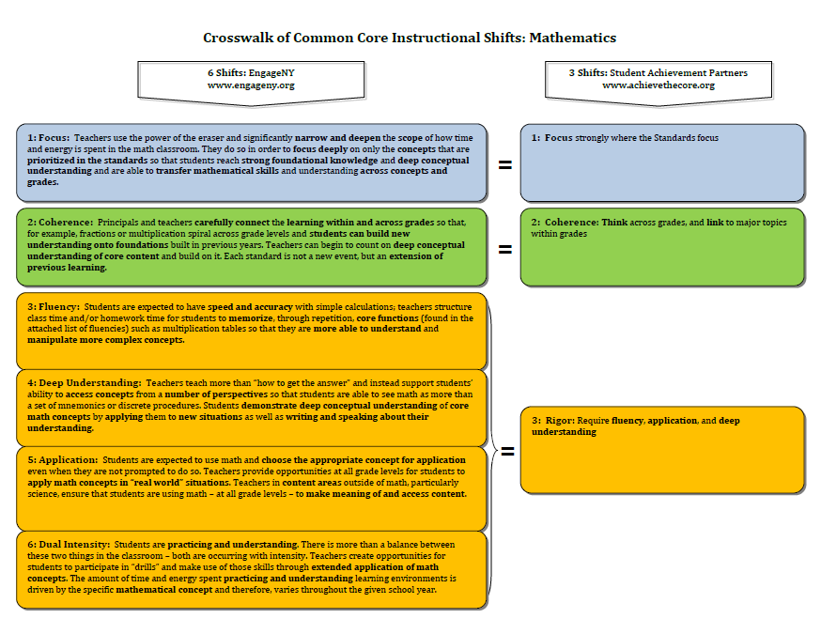
The Shifts

Slide 3
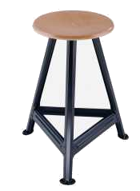
Shift of Rigor
Computation Fluency
Application
Conceptual Understanding
Notes:
Not all problems should be open-ended. It would be very hard to assess, and almost impossible to introduce new topics.
If you are trying to decide if a problem includes enough rigor ask yourself if it has these three charactaristics:
Does it assess the student’s conceptual understanding? Is there only 1 concept or multiple concepts being applied?
Does it require the student to have computational fluency? Have I looked at the fluencies for my level to be sure I am assessing them with this problem?
Does it require the student to problem solve? Does it make them think or does it give them everything they need?

Slide 4
Don’t forget the MPs!

Slide 5
Key Points – Modeling in the Standards
Application is the students’ ability to use relevant conceptual understandings and appropriate strategies and tools even when not prompted to do so.
Modeling can be descriptive, using concrete materials or pictorial displays to study quantitative relationships, or analytical, using equations or statistical representations to provide analysis of the relationships between variables (quantities).
A curriculum rich in application, including modeling, provides coherence from PK – 12 and beyond, to college and career.
Notes:
Let’s review some key points of this session. (CLICK TO ADVANCE EACH BULLET.)
Application is the students’ ability to use relevant conceptual understandings and appropriate strategies and tools even when not prompted to do so.
Modeling can be descriptive, using concrete materials or pictorial displays to study quantitative relationships, or analytical, using equations or statistical representations to provide analysis of the relationships between variables (quantities).
A curriculum rich in application, including modeling, provides coherence from PK – 12 and beyond, to college and career.

Slide 6
It’s all in a name…
Bar Models
Model drawings
Tape Diagrams

Slide 7
Accepted Best Practice for New Learning
Concrete (manipulatives/hands-on)
Pictorial (pictures/models)
Abstract (numbers/equations)

Slide 9
Steps to Bar Modeling (Char Forsten) (depends on who you ask!)
Step 1: Read the entire problem
Step 2: Rewrite the question in sentence form, leaving a space for the answer.
Step 3: Determine who and/or what is involved in the problem.
Step 4: Draw the unit bar(s).
Step 5: Chunk the problem, adjust the unit bars, and fill in the question mark.
Step 6: Correctly compute and solve the problem.
Step 7: Write the answer in the sentence and make sure the sentence makes sense.
Notes:
We will have common steps to problem solving.
How great would it be to KNOW that we are all teaching these to our kids??
Using the same terminology, the same expectations, just increasing the rigor of the question.
We will never have to question again…”Mr. Vibbard never taught us that.”

Slide 10
Steps to Bar Modeling (Bob Hogan-Char Forsten)
Step 1: Read the entire problem
Step 2: Decide WHO is in the problem.
Step 3: Decide WHAT is in the problem.
Step 4: Draw the unit bar(s).
Step 5: Read each sentence, one at a time, adjusting the bar(s) as needed.
Step 6: Put the QUESTION MARK in place.
Step 7: WORK COMPUTATION to the side or underneath.
Step 8: ANSWER the question in a complete sentence.
Notes:
We will have common steps to problem solving.
How great would it be to KNOW that we are all teaching these to our kids??
Using the same terminology, the same expectations, just increasing the rigor of the question.
We will never have to question again…”Mr. Vibbard never taught us that.”

Slide 11
Steps to Bar Modeling (Common Core, Inc.)
Step 1: Read the entire problem
Step 2: Ask yourself, “CAN I DRAW SOMETHING?”
Step 3: Draw a picture (bar(s) or other)
Step 4: Read each sentence, one at a time, adjusting the picture as needed.
Step 5: WORK COMPUTATION to the side or underneath.
Step 6: ANSWER the question in a complete sentence.
Notes:
We will have common steps to problem solving.
How great would it be to KNOW that we are all teaching these to our kids??
Using the same terminology, the same expectations, just increasing the rigor of the question.
We will never have to question again…”Mr. Vibbard never taught us that.”

Slide 12
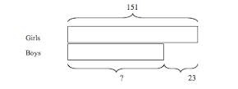
Types of Models
Part-Whole
Comparison

Slide 13
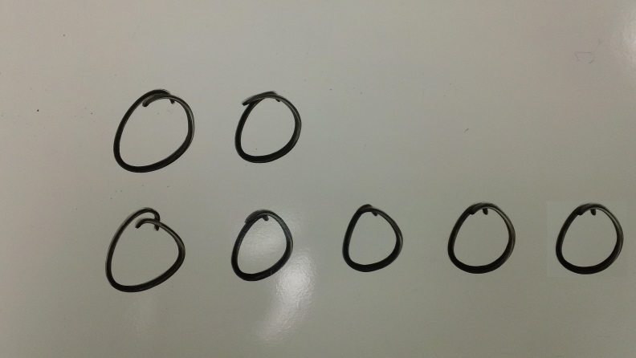
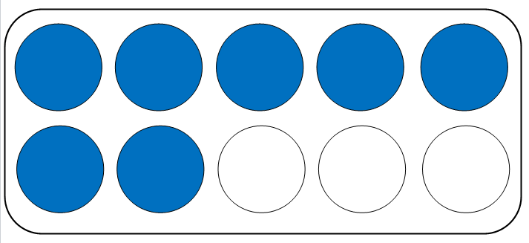
Foundations for Tape Diagrams in PK–1
Notes:
In the very early grades, we count out objects, and do comparisons of quantities (e.g., Who has more? Who has fewer? How many more? How many fewer?). It is important that students see groups of objects in many arrangements and learn to instantly recognize quantities up to 5 or 6. But it is equally important that we begin modeling for students the laying out of objects in an organized fashion that previews bar modeling, in both the end-to-end fashion and the comparison fashion. This is especially appropriate when working with word problems of addition and subtraction.
As the teacher, model a comparison of two quantities in the manor that makes the comparison easiest to see. It is not recommended to become overly structured in forcing students to model it a certain way every time. The suggestion, ”This time can you lay yours out like I have mine” will serve to build this habit of setting up items in rows to support counting, comparison, and the model of using rectangular bars.

Slide 14
Kindergarten!

Slide 16
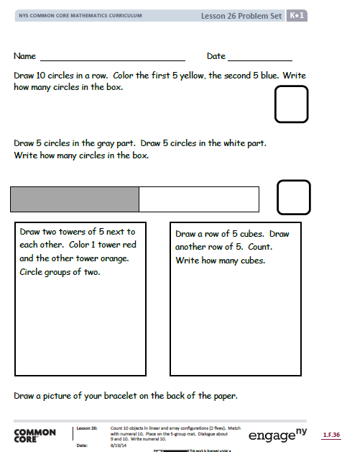

Slide 17
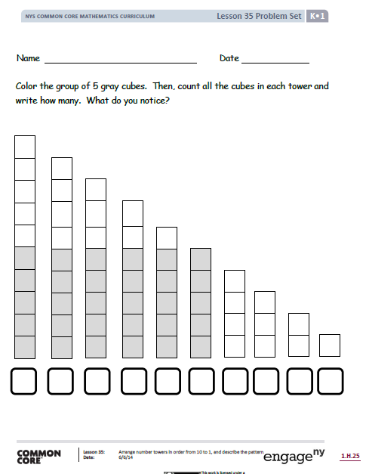

Slide 18
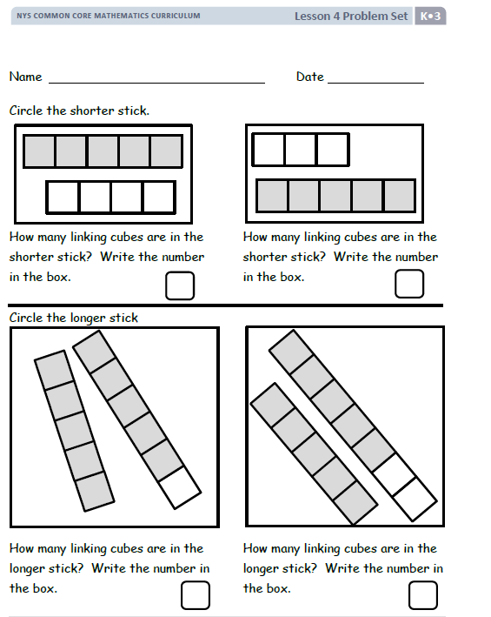

Slide 19
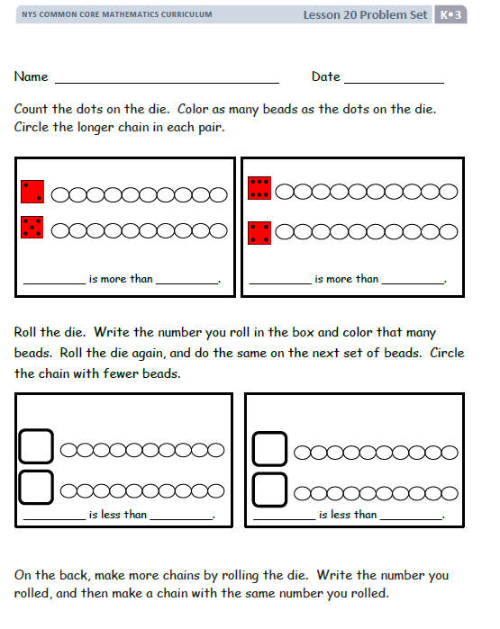

Slide 20
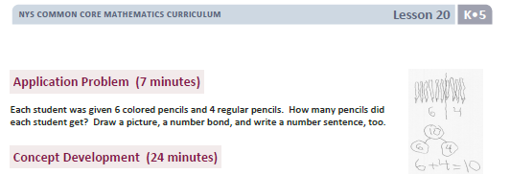

Slide 21
Illustration 2
Janet picked 3 daisies and 2 sunflowers from her garden. How many total flowers did Janet pick from her garden?
5
Janet picked a total of _____ flowers from her garden.
Janet’s
Flowers
?
Notes:
Kindergarten: K.OA.1: Understand addition as putting together and adding to, and understand subtraction as taking apart and taking from. 1. represent addition and subtraction with objects, fingers, mental images, drawing, sounds (e.g. claps) acting out situation, verbal explanations, expression or equations. Drawings need not show details, but should show the mathematics in the problem.
Step 1: Read the entire problem
Step 2: Rewrite the question in sentence form, leaving a space for the answer.
Step 3: Determine who and/or what is involved in the problem.
Step 4: Draw the unit bar(s).
Step 5: Chunk the problem, adjust the unit bars, and fill in the question mark.
Step 6: Correctly compute and solve the problem.
Step 7: Write the answer in the sentence and make sure the sentence makes sense.

Slide 22
Grade 1!

Slide 26
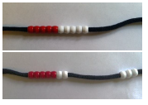

Slide 34
Illustration 1
Sara has 5 stamps. Mark has 3 stamps. How many more stamps does Sara have than Mark?
Sara’s stamps
Mark’s stamps
2
Sara has ________ more stamps than Mark.
Notes:
The transition into bar diagrams requires transitioning from sets of actual objects to pictures of objects, to bar-shaped pictures that still depict individual objects, and then to rectangular bars with no distinct markings of individual items.
A benefit of using rectangular bars without the markings of individual items is that students can now model non-discrete quantities – like measurements of distance or weight – as well as being able to represent unknown quantities.

Slide 35
Grade 2!

Slide 37
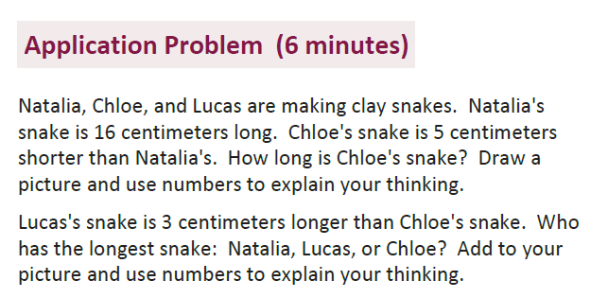
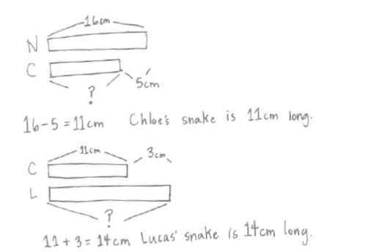

Slide 40
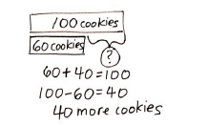

Slide 41
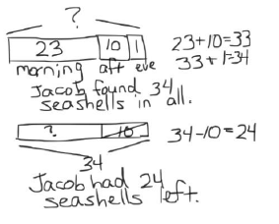

Slide 42
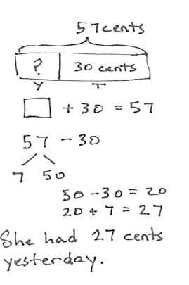

Slide 43
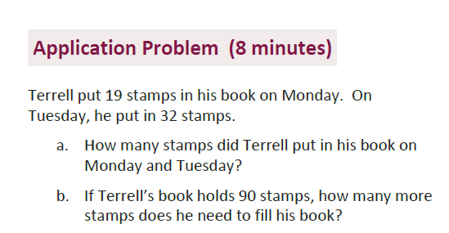
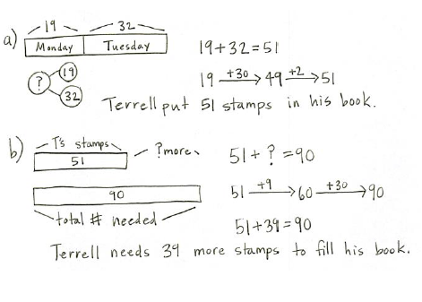

Slide 44
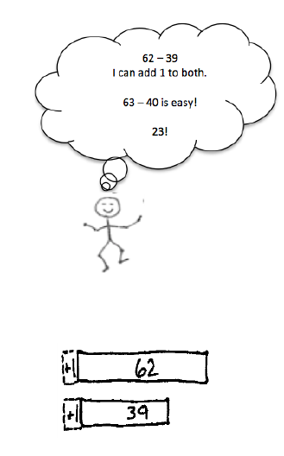
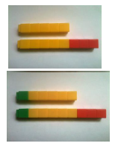

Slide 45
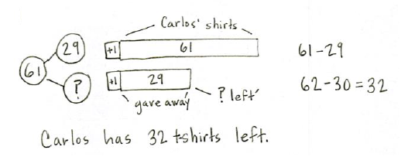

Slide 47
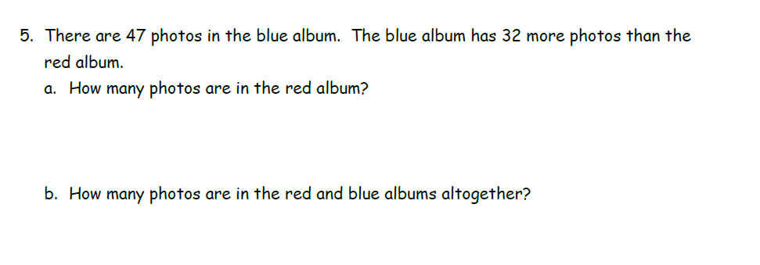

Slide 48
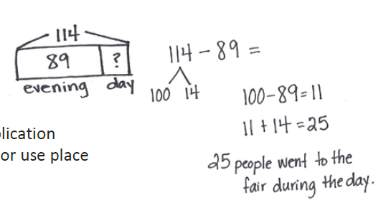

Slide 49
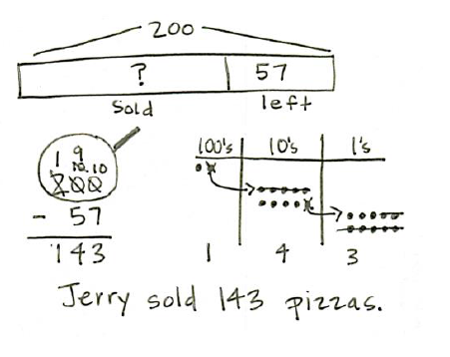

Slide 50
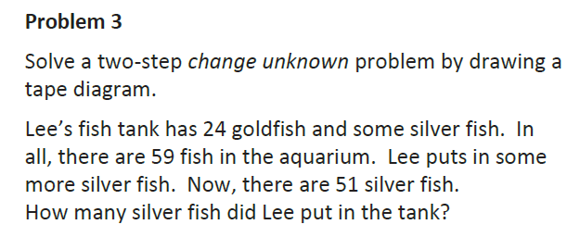

Slide 51
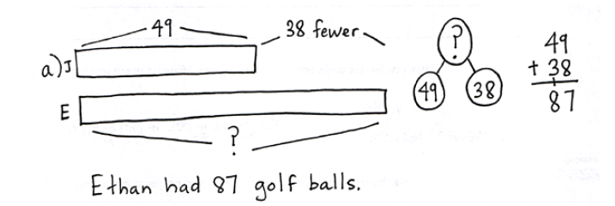
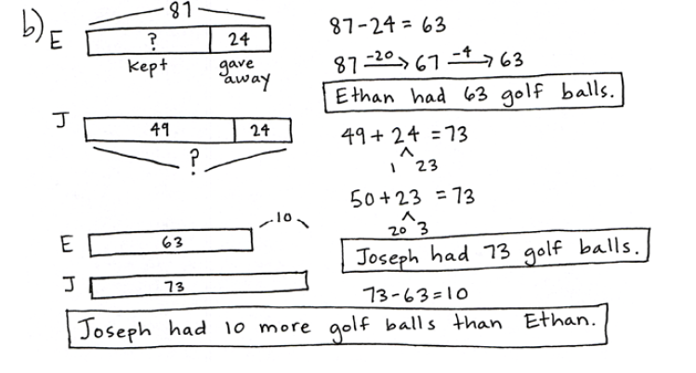

Slide 52
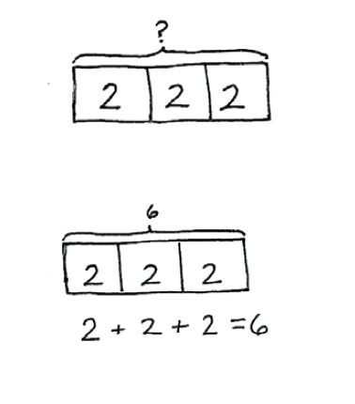

Slide 54
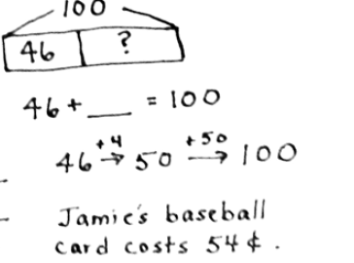
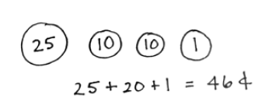

Slide 56
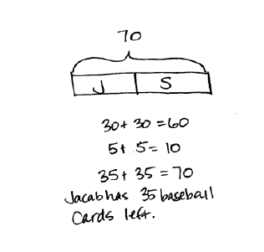

Slide 57
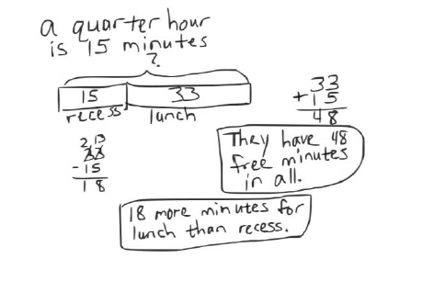

Slide 58
Grade 3!

Slide 59
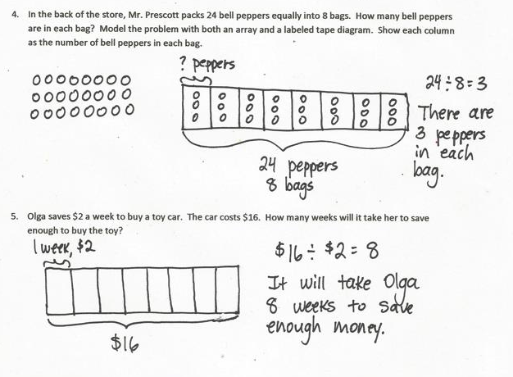

Slide 60
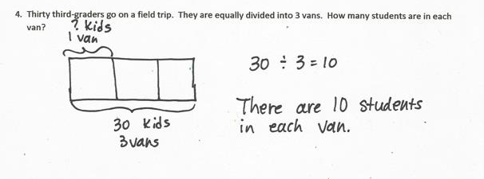

Slide 62
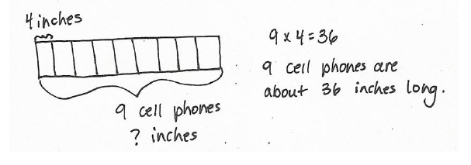

Slide 63
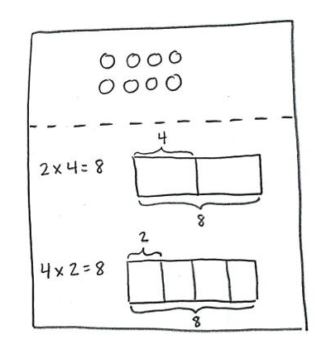

Slide 66
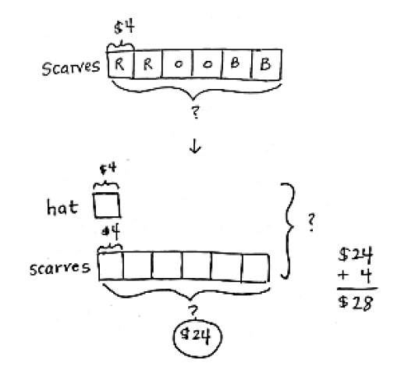

Slide 67
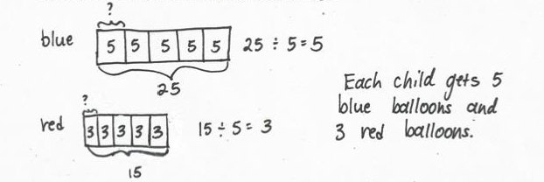

Slide 70
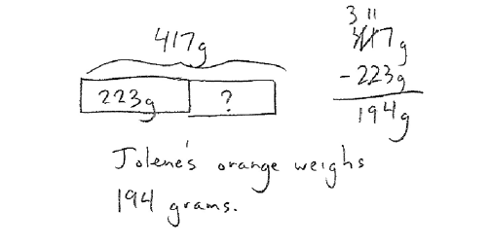

Slide 71
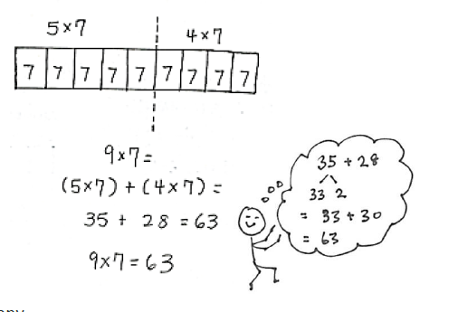
The Distributive Property!

Slide 72
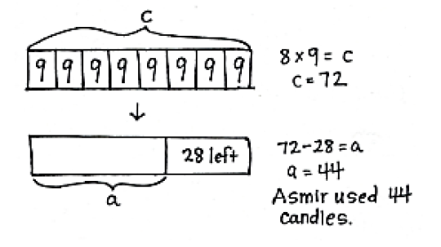

Slide 73
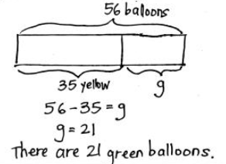
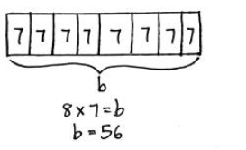

Slide 74
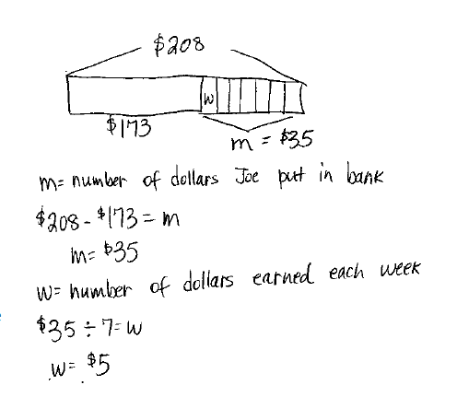

Slide 75
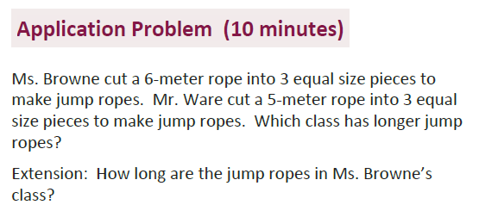
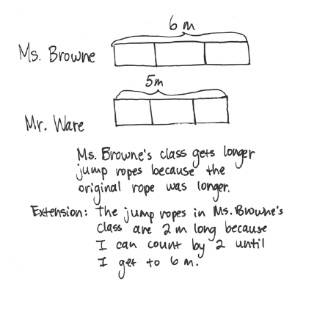

Slide 76
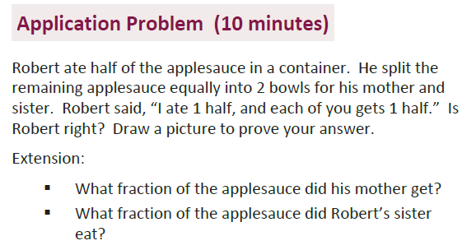
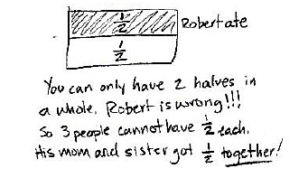
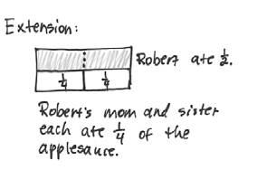

Slide 77
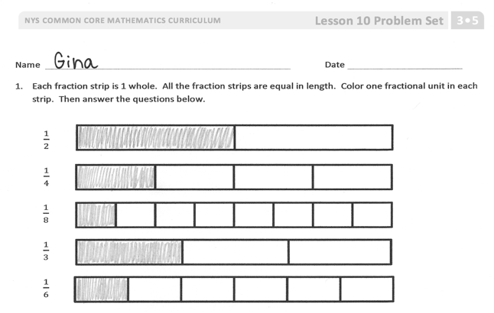
Fraction strips & Tape Diagrams

Slide 78
How Number Lines Fit into the Mix

Slide 83
Released Items from NYS Math 3 - 2014

Slide 88
Grade 4!

Slide 119
Released Items from NYS Math 4 - 2014

Slide 131
Grade 5!

Slide 144
100
24¾
24¾
19 $\frac{3}{8}$
?

Slide 147
or

Slide 148
5 ÷ 2 = $\frac{5}{2}$ = 2$\frac{1}{2}$

Slide 167
Released Items from NYS Math 5 - 2014

Slide 180
Grade 6!

Slide 182
?
192
?

Slide 194
$$\frac{7}{3}$$
$$one group$$
$$of \frac{2}{3}$$
$$one group$$
$$of \frac{2}{3}$$
$$one group$$
$$of \frac{2}{3}$$
1/2$group$
$$of \frac{2}{3}$$
7/3 divided by 2/3 = 3$\frac{1}{2}$

Slide 195
$$\frac{0}{2}$$
$$\frac{1}{2}$$
$$\frac{2}{2}$$
$$\frac{3}{2}$$
$$\frac{4}{2}$$
$$\frac{5}{2}$$
$$\frac{6}{2}$$

Slide 205
Released Items from NYS Math 6 - 2014

Slide 213
Grade 7!

Slide 230
Released Items from NYS Math 7 - 2014

Slide 240
Grade 8!

Slide 241
What are those integers?
Integer 1
x
Integer 2
x
Integer 3
x
3x + 6 = 93
3x = 87
x = 29
x + 2 = 31
x + 3 = 33
29+31+33 = 93

Slide 242
Released Items from NYS Math 8 - 2014

