Slide 1
Don’t Be Fooled By The Bells and Whistles: Approaching Program Adoption with a Critical Eye
National Council of Supervisors of Mathematics Conference (Session 3205)
Sallie Kaan and Ashley Nestor
April 2017
*You’ll need your device for participation in a
Kahoot survey during the presentation.

Slide 2
Session Goals
Learn about a research-based approach a district used to prepare teachers to analyze curricular resources with a critical eye.
Leave with the research, strategies, and professional development tools needed to ensure a thoughtful adoption of CCSS materials.

Slide 3
What are the first 2 thoughts/words that come to mind when you think about the prospect of a new math adoption?

Slide 4
Getting to Know Our Schools and Participants
Kahoot
www.kahoot.it
Enter Game Pin and Nickname
Table Talk
If I could work through the selection process again, I would….
replicate the same process (GREEN CARD)
change or do things differently (RED CARD)

Slide 6
Learning from Past Practice
• Different Philosophies
• Shallow Understanding of Standards and Progressions
3.NF.3: Explain equivalence of fractions in special cases, and compare fractions by reasoning about their size.
• Lack of Set Criteria
• Failure to Prepare for Limitations

Slide 7
Process Overview
Session #1: Principles to Actions Kick-Off
Session #2: Unpacking the Standards for Mathematical Practice
Session #3: Unpacking the Common Core State Standards
Session #4: Building the Blend of Procedural Fluency and Conceptual Understanding
Session #5: Math Tasks and Talk
Session #6: Practice with NCSM-NCTM Curricular Materials Analysis Tools

Slide 8
Session #1: Principles to Actions Kick-Off
Obtain a baseline of members’ beliefs associated with the teaching and learning of math
Share committee vision
Introduce the Effective Mathematics Teaching Practices
Distribute copies of Principles To Actions

Slide 9
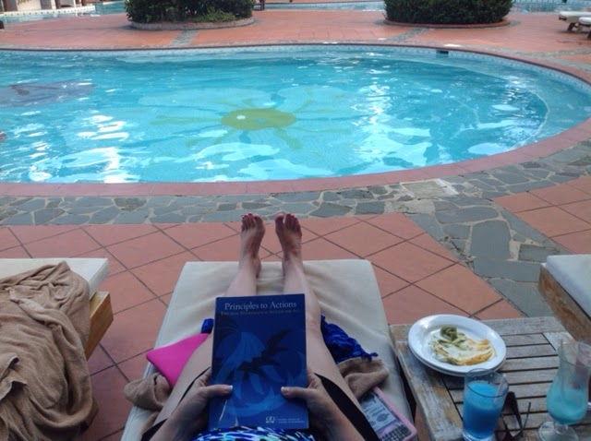
PRIZE TIME!

Slide 10
Session #2: Unpacking the Standards for Math Practice
Solve various math tasks and determine the Standards for Math Practices emphasized
Share Question Stems that elicit the Standards for Math Practice

Slide 11
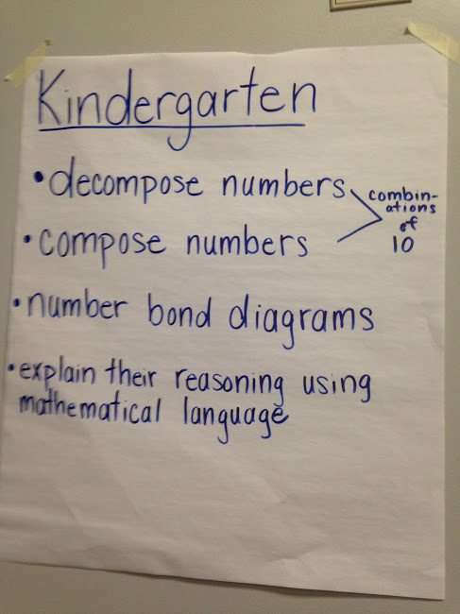
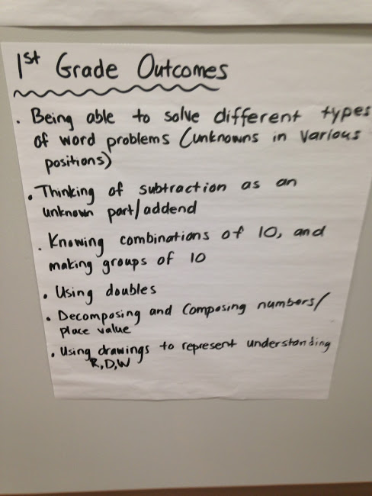
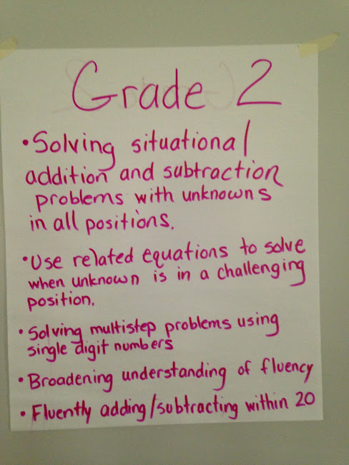
Session #3: Unpacking the Common Core
State Standards
Deepen understanding of Common Core State Standards within and across grade levels

Slide 12
Session #4: Building the Blend of Procedural Fluency
and Conceptual Understanding
Emphasize the importance of building the procedural fluency from conceptual understanding
Study the progression of informal strategies to standard algorithms and how these are developed within curricular resources
Analyze student strategies and work to reveal their understandings or misunderstandings

Slide 13
PRIZE TIME!
Session #5: Math Tasks and Talk
Analyze various math tasks to determine the level of cognitive demand
Introduce of levels of cognitive demand
Implement tasks in ways that maintain rigor and discussion
“The success of students in high achieving schools was due in part to the high cognitive demand of the curriculum and the teachers’ ability to maintain the level of demand during enactment through questioning.” (Boaler and Staples, 2008)

Slide 14
Session #6: Practice with NCSM-NCTM Curricular Materials Analysis Tools
Common Core Curriculum Materials Analysis Tools

Slide 15
Session #6: Practice with NCSM-NCTM Curricular Materials Analysis Tools
FCASD Curriculum Analysis Tool

Slide 16
Next Steps
More work with FCASD Curriculum Analysis Tool
Site Visits
Teacher Focus Groups
Pilot

Slide 17
Program Closure and Reflection
How might you now approach program adoption differently? What are some things your district hasn’t considered in the past that you see as being non-negotiable for future adoptions? (YELLOW POST IT)
Which materials or resources might you use for PD to support
a thoughtful adoption? (PINK POST IT)
Notes:
.

Slide 18
Key Takeaways
Craft a vision
Plan for PD that unifies committee thinking to support current research and the district’s vision
Create a collaborative culture
Provide ample time for in-depth analysis and reflection
Bring publishing companies in at the end
AND MOST IMPORTANTLY….
“Don’t Be Fooled by the Bells and Whistles”

Slide 19
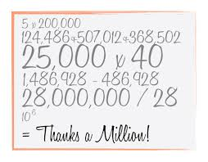
PRIZE
TIME!

Slide 20
Evaluation in
NCSM Conference APP
Log into NCSM conference APP
Click on our session
Scroll to evaluation icon
Respond to these 4 questions:
Please rate this overall session. Scale of 1-5
Please rate the presenter. Scale of 1-5
How well did the session meet your expectations?
What else would you like to tell us about this session?

