Slide 1
Don’t Be Fooled By The Bells and Whistles: Approaching Program Adoption with a Critical Eye-Epilogue
National Council of Supervisors of Mathematics Conference
(Session 3125)
Sallie Kaan and Ashley Nestor
April 2018
*You’ll need your device for participation during the presentation.

Slide 2
Epilogue

Slide 3
Menti.com
What are the first 2 thoughts/words that come to mind when you think about the prospect of a new math adoption?

Slide 4
Session Goals
Learn about a research-based approach a district used to prepare teachers to analyze curricular resources with a critical eye.
Leave with the research, strategies, and professional development tools needed to ensure a thoughtful adoption of CCSS materials.

Slide 5
Reflection
Kahoot
www.kahoot.it
Enter Game Pin and Nickname
Table Talk
If I could work through the selection process again, I would….
replicate the same process
change or do things differently

Slide 7
Learning from Past Practice
• Different Philosophies of Math Teaching and Learning
• Shallow Understanding of Standards and Progressions
3.NF.3: Explain equivalence of fractions in special cases, and compare fractions by reasoning about their size.
• Lack of Set Criteria
• Failure to Prepare for Limitations

Slide 8
Process Overview
Session #1: Principles to Actions Kick-Off
Session #2: Unpacking the Standards for Mathematical Practice
Session #3: Unpacking the Common Core State Standards
Session #4: Building the Blend of Procedural Fluency and Conceptual Understanding
Session #5: Math Tasks and Talk
Session #6: Practice with NCSM-NCTM Curricular Materials Analysis Tools

Slide 9
Session #1: Principles to Actions Kick-Off
Obtain a baseline of members’ beliefs associated with the teaching and learning of math
Share committee vision
Introduce the Effective Mathematics Teaching Practices
Distribute copies of Principles To Actions

Slide 10
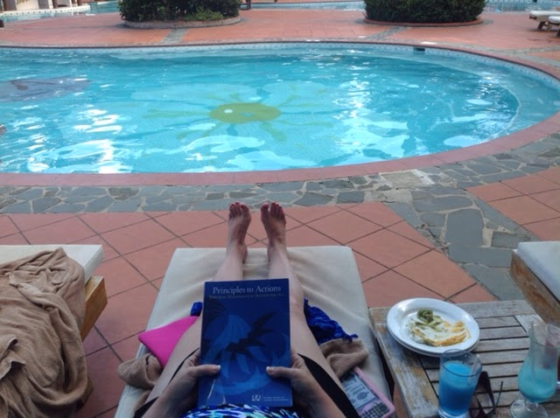
PRIZE TIME!

Slide 11
Session #2: Unpacking the Standards for Math Practice
Solve various math tasks and determine the Standards for Math Practices emphasized
Share Question Stems that elicit the Standards for Math Practice

Slide 12
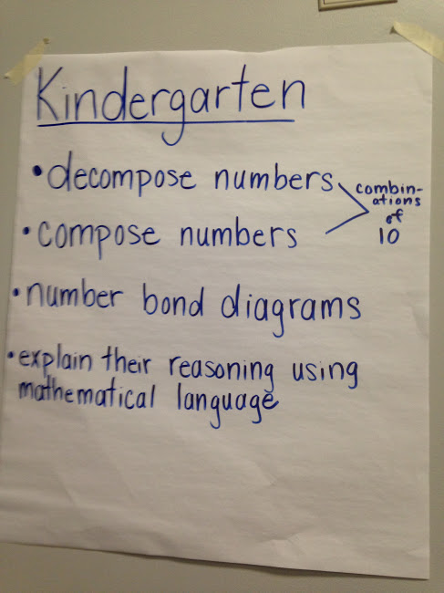
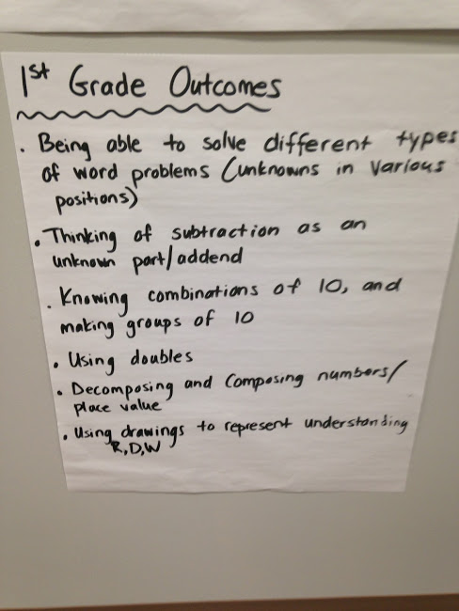
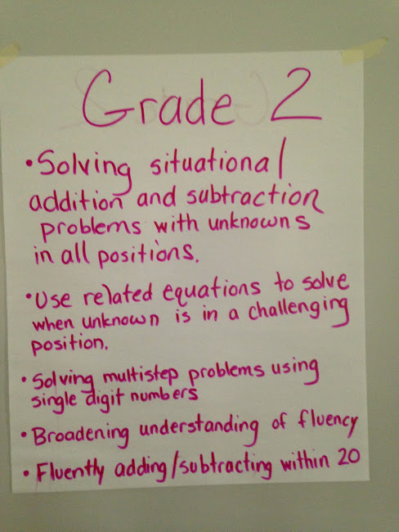
Session #3: Unpacking the Common Core
State Standards
Deepen understanding of Common Core State Standards within and across grade levels

Slide 13
Session #4: Building the Blend of Procedural Fluency
and Conceptual Understanding
Emphasize the importance of building the procedural fluency from conceptual understanding
Study the progression of informal strategies to standard algorithms and how these are developed within curricular resources
Analyze student strategies and work to reveal their understandings or misunderstandings

Slide 14
PRIZE TIME!
Session #5: Math Tasks and Talk
“The success of students in high achieving schools was due in part to the high cognitive demand of the curriculum and the teachers’ ability to maintain the level of demand during enactment through questioning.” (Boaler and Staples, 2008)
Analyze various math tasks to determine the level of cognitive demand
Introduce of levels of cognitive demand
Implement tasks in ways that maintain rigor and discussion

Slide 15
Session #6: Practice with NCSM-NCTM Curricular Materials Analysis Tools
Common Core Curriculum Materials Analysis Tools
Key Questions
• To what extent will these materials support faithful implementation of the CCSSM?
• What are the flaws?

Slide 16
Preparation for Publisher Presentations
•Narrowed Programs
•Examined TE, SE and Assessments
•Modified Tool
•FCASD Curriculum Analysis Tool

Slide 17
Best Laid Plans . . .
Site Visits
Data Monitoring
New Pilot (*if needed)
(All while continuing with current program.)

Slide 18
Student Achievement Gains on PSSA
 | All Students
 | 2014-2015 | 2016-2017 | Gains
3rd Grade | 80.6% | 88.1% | +7.5%
4th Grade | 70.0% | 80.0% | +10.0%
5th Grade | 70.9% | 77.5% | +6.6%

Slide 19
Student Achievement Gains on PSSA
 | Education/Learning Support
 | 2014-2015 | 2016-2017 | Gains
3rd Grade | 29.2% | 57.9% | +28.7%
4th Grade | 25.0% | 43.6% | +18.6%
5th Grade | 21.4% | 23.1% | +1.7%

Slide 20
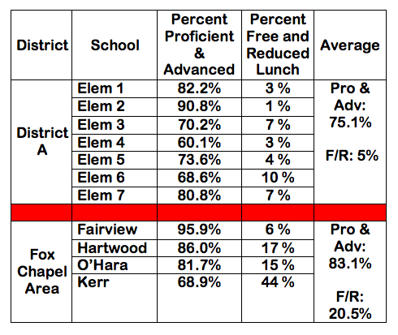

Slide 21
Our Epilogue
Not going to look further
Hold committee meetings
Fixable Flaws
Modify Assessments, Supplemental Materials, Parent Education Piece, Professional Development, etc.

Slide 22
Program Closure and Reflection
How might you now approach program adoption differently? What are some things your district hasn’t considered in the past that you see as being non-negotiable for future adoptions? (YELLOW POST IT)
2. Which materials or resources might you use for PD to support a thoughtful adoption? (PINK POST IT)

Slide 23
Key Takeaways
Craft a vision
Plan for PD that unifies committee thinking to support current research and the district’s vision
Create a collaborative culture
Provide ample time for in-depth analysis and reflection
Bring publishing companies in at the end
AND MOST IMPORTANTLY….
“Don’t Be Fooled by the Bells and Whistles”

Slide 24
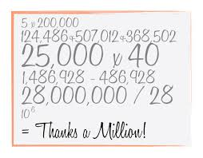
PRIZE
TIME!

Slide 25
Evaluation in
NCSM Conference APP
Log into NCSM conference APP
Click on our session
Scroll to evaluation icon
Respond to these 4 questions:
Please rate this overall session. Scale of 1-5
Please rate the presenter. Scale of 1-5
How well did the session meet your expectations?
What else would you like to tell us about this session?

Slide 26
New York City

